Slide 1
Final Project VaR and CVaR calculation using ARIMA model to predict stock prices

Slide 2
Value at Risk (VAR) is a statistic that is used in risk management to predict the greatest possible losses over a specific time frame.
Conditional Value at Risk (CVaR), also known as the expected shortfall, is a risk assessment measure that quantifies the amount of tail risk an investment portfolio has.

Slide 3
The goal of this project is to understand how ARIMA model works predicting prices for calculating the VaR and CVaR

Slide 4
An autoregressive integrated moving average, or ARIMA, is a statistical model that uses time series data to predict future trends.
A statistical model is autoregressive if it predicts future values based on past values.

Slide 5
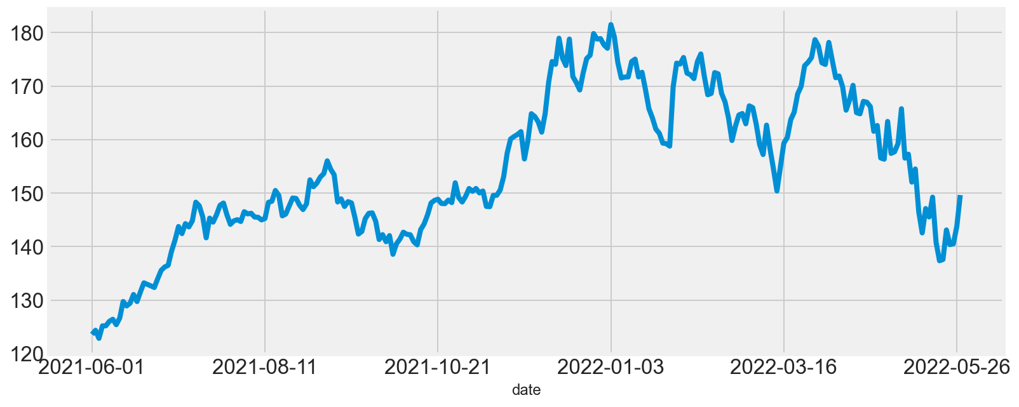
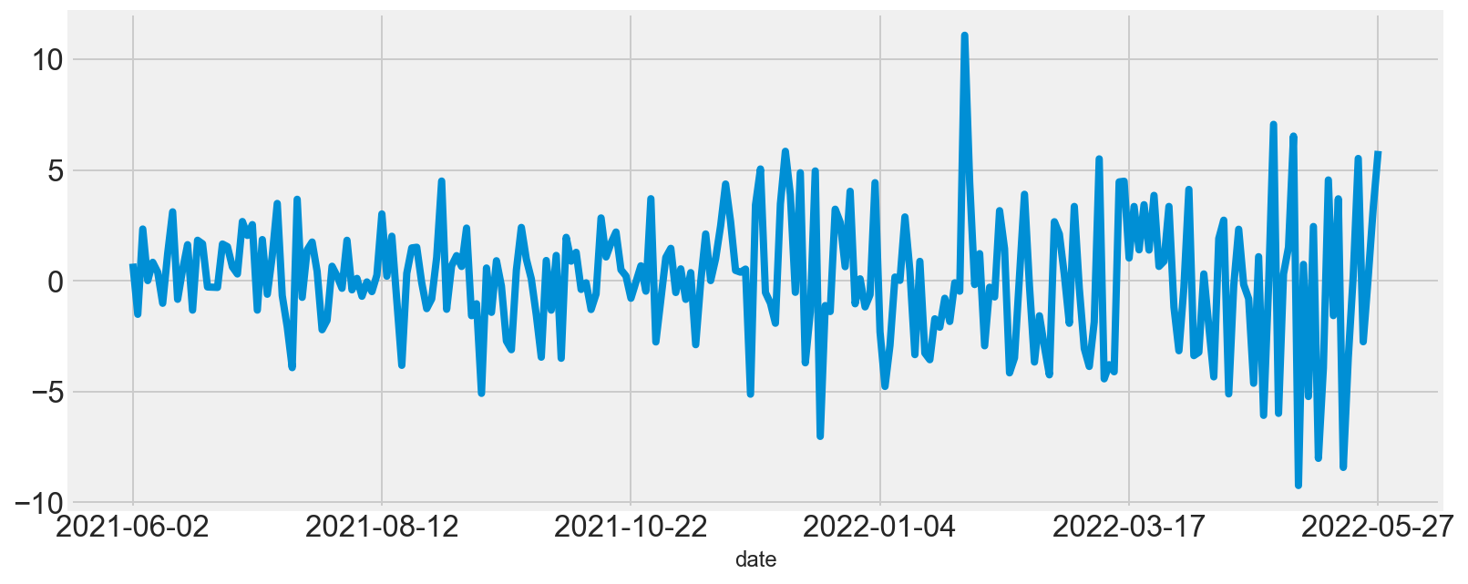
Apple Stock prices from last year
Apple Stock prices differenciated

Slide 6
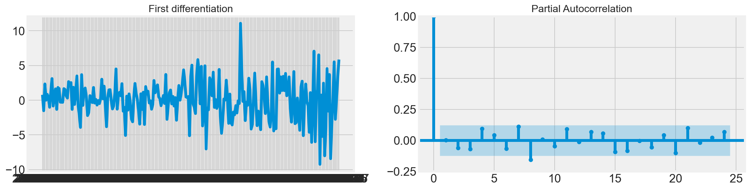
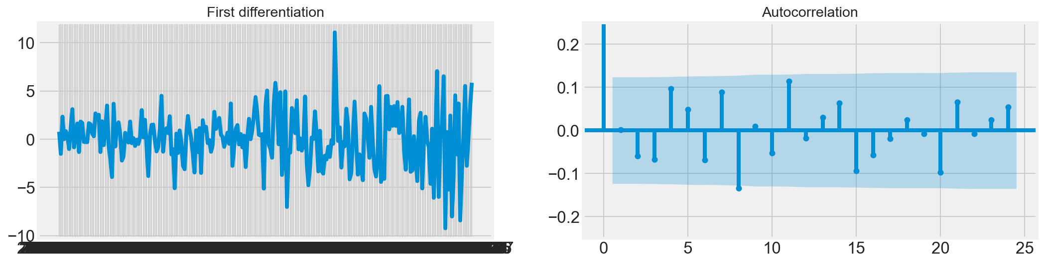
Autocorrelation Function (ACF)

Slide 7
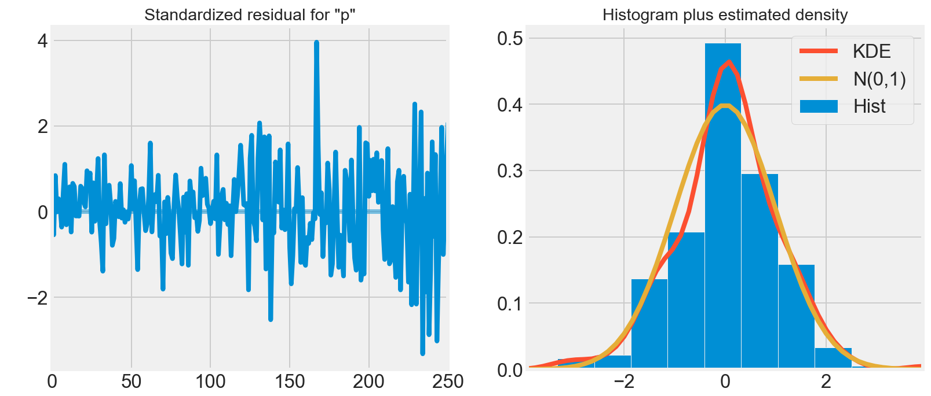
Residuals with constant mean and variance

Slide 8
ARIMA Model Results
==============================================================================
Dep. Variable: D.price No. Observations: 201
Model: ARIMA(1, 1, 1) Log Likelihood -462.069
Method: css-mle S.D. of innovations 2.410
Date: Sun, 26 Jun 2022 AIC 932.137
Time: 18:11:11 BIC 945.350
Sample: 1 HQIC 937.484
=================================================================================
coef std err z P>|z| [0.025 0.975]
---------------------------------------------------------------------------------
const 0.1855 0.179 1.037 0.300 -0.165 0.536
ar.L1.D.price -0.8146 0.123 -6.633 0.000 -1.055 -0.574
ma.L1.D.price 0.9108 0.089 10.198 0.000 0.736 1.086

Slide 9
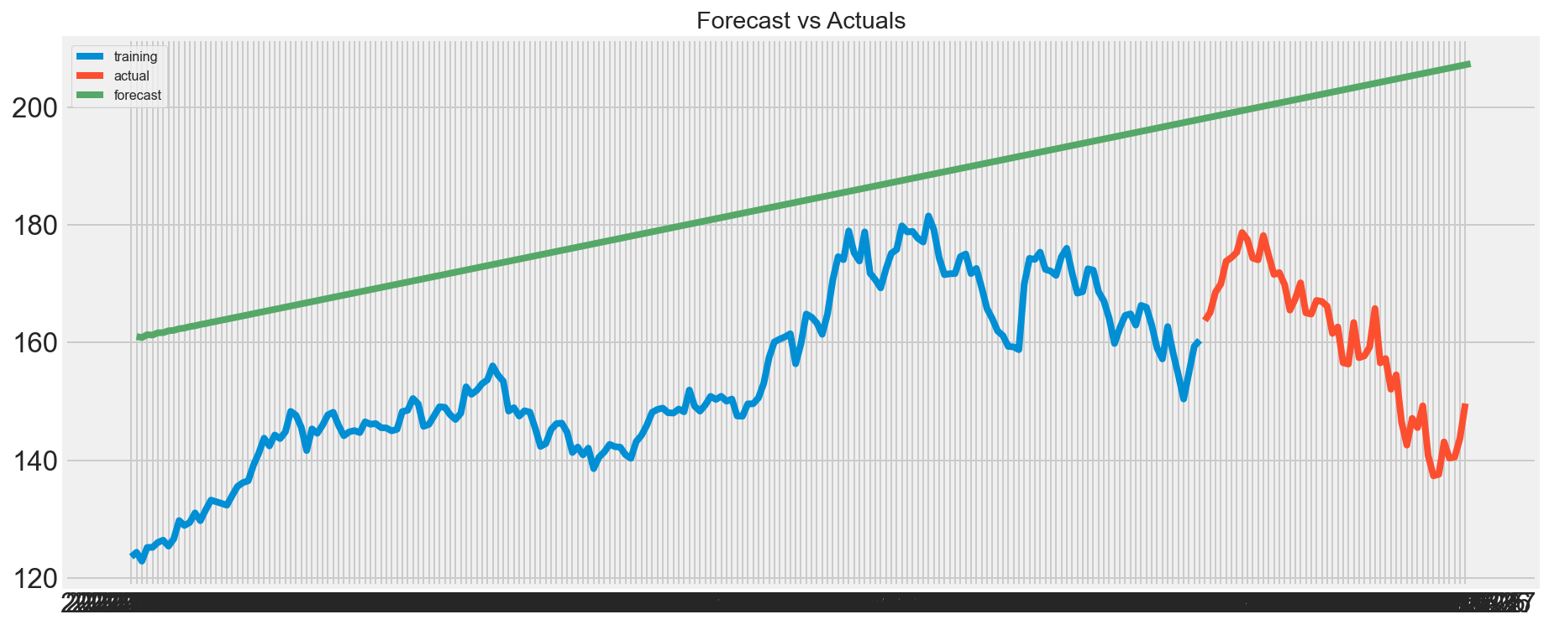

Slide 10
ARIMA models are a subset of linear regression models that use the past observations of the target variable to forecast its future values. A key aspect of ARIMA models is that they do not consider exogenous variables. It can be easily and accurately used for short-term forecasting but not long term.

